Slide 1
EXAM SEATING ARRANGEMENT
Team Members:
Yuktha Alumuri(2520090093)
G.Shivani(2520090046)

Slide 2
ABSTRACT
he Smart Examination Seating Arrangement System is a Python-based application developed using the Tkinter GUI library to automate the process of arranging students in examination halls. The system is designed to reduce manual effort, improve accuracy, and provide an organized method for seat allocation during examinations. It stores student details such as Hall Ticket Number, Name, and Department, and generates a systematic seating arrangement automatically.
The application distributes students from different departments, including CSE, ECE, AIDS, and CSIT, in a structured manner to maintain fairness and reduce the possibility of malpractice during examinations. The system provides a simple graphical user interface through which administrators can view student information and generate seating arrangements with a single click.
The generated seating plan is displayed instantly, enabling quick verification and management of examination halls. By automating the seating allocation process, the system minimizes human errors, saves time, and enhances examination administration efficiency. This project serves as a foundation for future enhancements such as database integration, online management, report generation, and advanced seat allocation techniques.

Slide 3
OBJECTIVES
To automate the examination seating arrangement process.
To reduce manual work and human errors in seat allocation.
To provide a user-friendly graphical interface for administrators.
To maintain a systematic distribution of students from different departments.
To display student information efficiently.
To generate seating arrangements quickly and accurately.
To improve examination hall management and organization.
To ensure fair and transparent seat allocation.
To save time during examination planning and execution.
To provide a scalable solution for educational institutions.

Slide 4
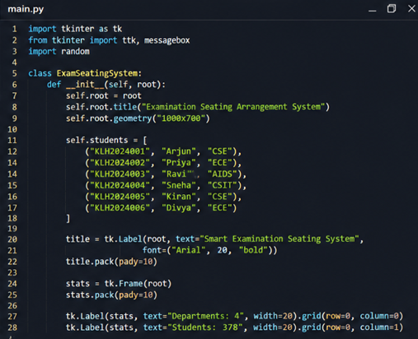
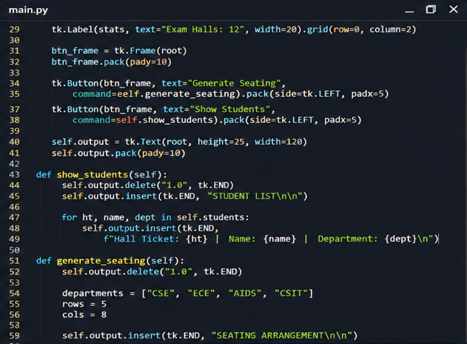
PYTHON EXCECUTION

Slide 5
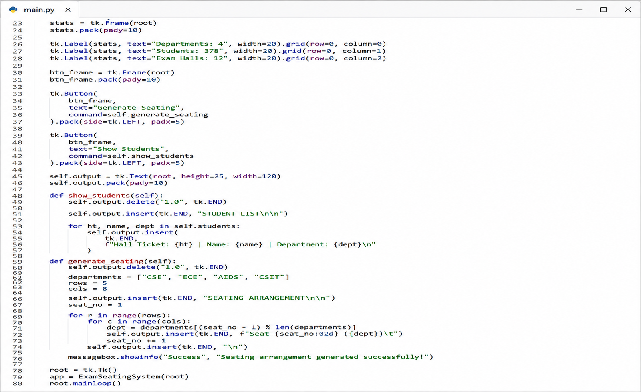

Slide 6
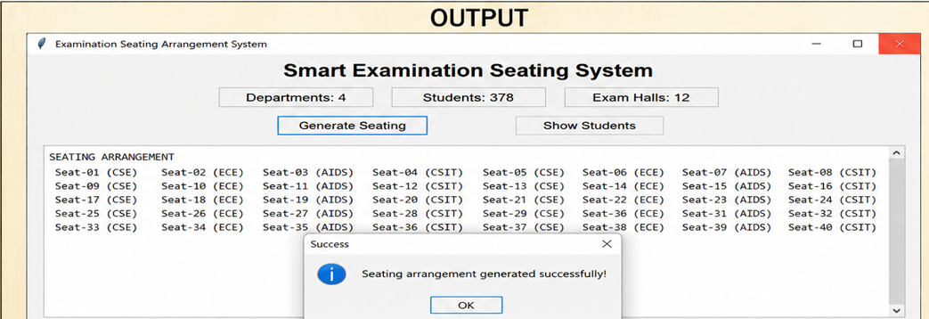

Slide 7
FUTURE SCOPE
Integration with MySQL or other databases for managing large student records.
Development of a web-based version using Django or Flask.
Automatic hall allocation based on student strength and hall capacity.
Generation of seating charts in PDF format.
Printing support for hall-wise seating arrangements.
Student login portal for checking seat allocation.
QR Code-based attendance management system.
Email and SMS notifications for students.
Cloud-based examination management system.
AI-based optimized seat allocation algorithms.
Multi-campus and multi-college examination management.
Real-time analytics and reporting dashboard.
Mobile application support for administrators and students.

Slide 8
THANK YOU

